Slide 1


APPLICATION CHEMISTRY
A2 LEVEL
ANALYTICAL CHEMISTRY
CHAPTER 7:
X-RAY CRYSTALLOGRAPHY

Slide 2

What you should know…

Slide 3
X-ray Crystallography
X-ray crystallography is a method of determining the arrangement of atoms within a crystal, in which a beam of X-rays strikes a crystal and diffracts into many specific directions.
From the angles and intensities of these diffracted beams, a crystallographer can produce a three-dimensional picture of the density of electrons within the crystal.
From this electron density,
the positions of the atoms in the crystal,
distance between atoms,
bond length and
bond angles
chemical bonds,
can be determined.

Slide 4
X-ray Crystallography
X-rays are very short (about 0.1 nm) wavelength electromagnetic rays.
An X-ray spectrometer consists of three main parts:
  an X-ray source
  a stable support on which the crystal is mounted, and which can be rotated by a measured angle around all three axes
  a system for detecting the reflected X-rays. This can be either a photographic film or a scintillation counter.

Slide 5
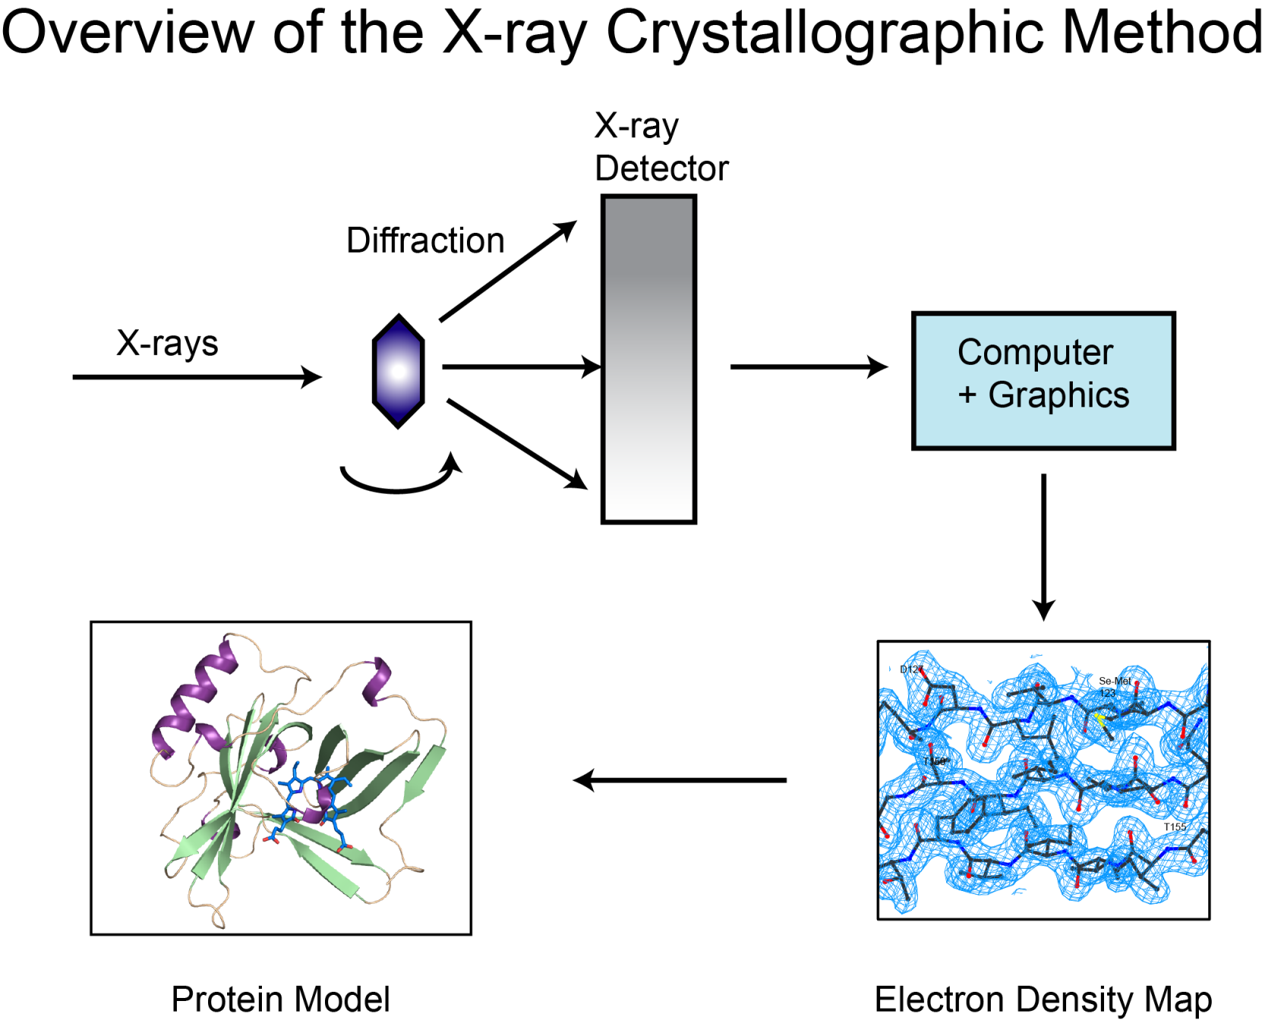

Slide 6
X-ray Crystallography
X-rays are diffracted by the electron clouds in the atoms of the crystal.
The electron clouds interact with the electric field of the X-rays.
All atoms except hydrogen contain enough electrons to diffract the X-rays, and the heavier the atom the more intense is the reinforcement of the beam.

Slide 7
X-ray Crystallography
By measuring the angles between the incident beam and the diffracted beams, and the relative intensities of those beams, we can piece together a picture of the electron density at all points in the unit cell.
Process requires an enormous number of calculations to be done, requiring many hours of high speed computer time.
Limiting factor is the production of a sufficiently pure crystal in the first place.

Slide 8
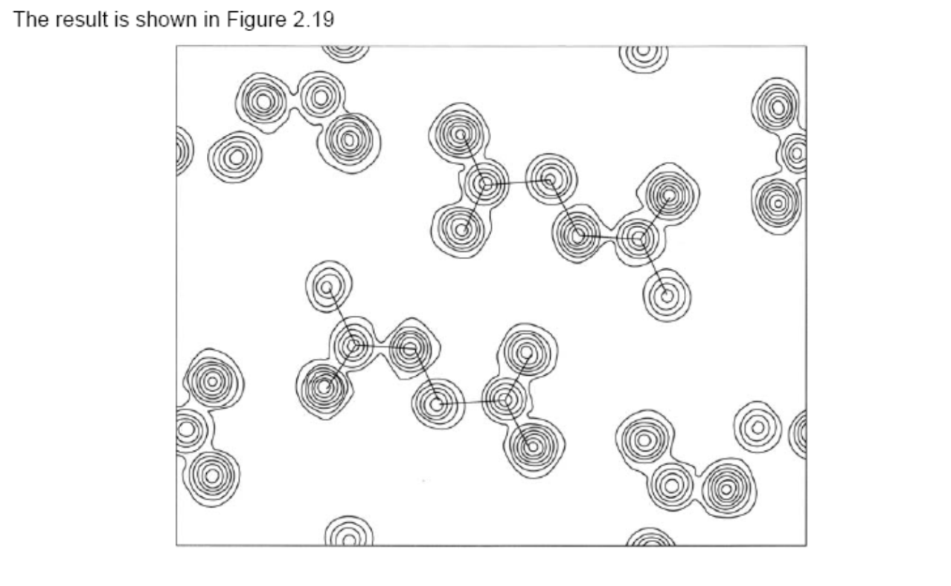
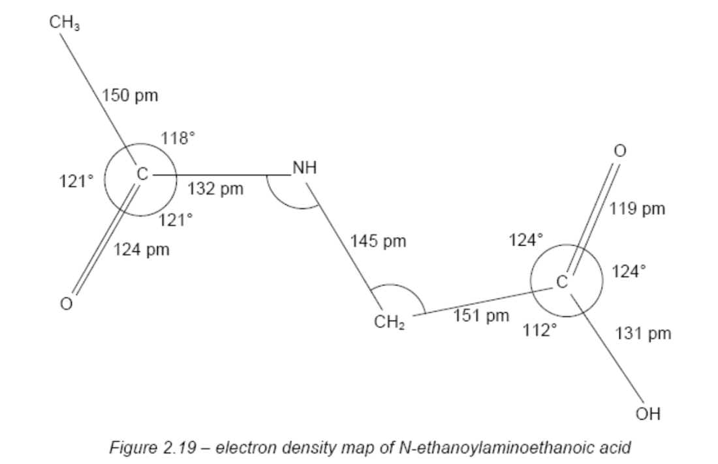
Ethanoylaminoethanoic acid

Slide 9
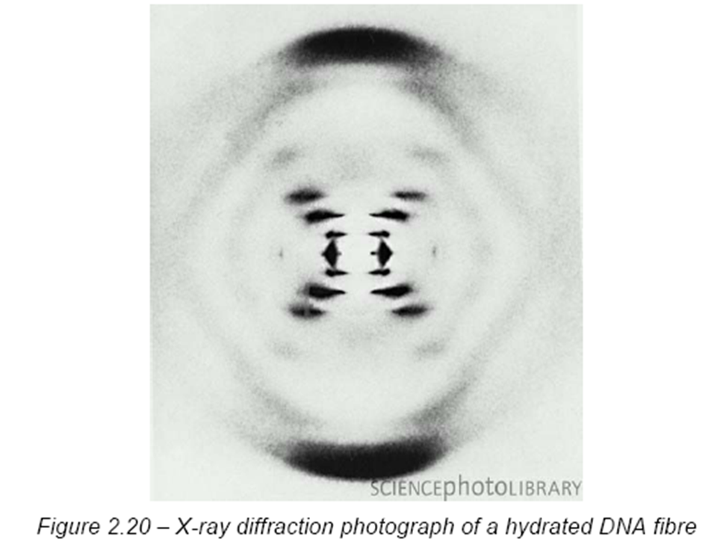
X-ray Crystallography

Slide 10
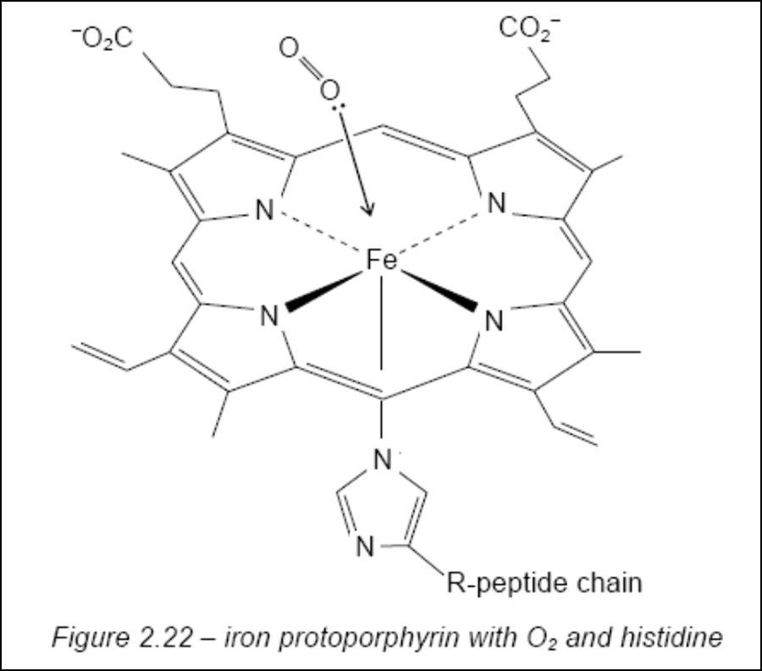
X-ray Crystallography
Myoglobin is an oxygen transporting agent and oxygen reservoir found in the muscular tissues of vertebrates.
It achieves its function by the use of a haem group.
This consists of a Fe²⁺ ion surrounded by a protoporphyrin ring.
The iron is bound to the polypeptide chain by an Fe-N covalent bond to a histidine residue.
The oxygen molecule is transported by forming a dative bond to the Fe²⁺ ion (Figure 2.22).

Slide 11
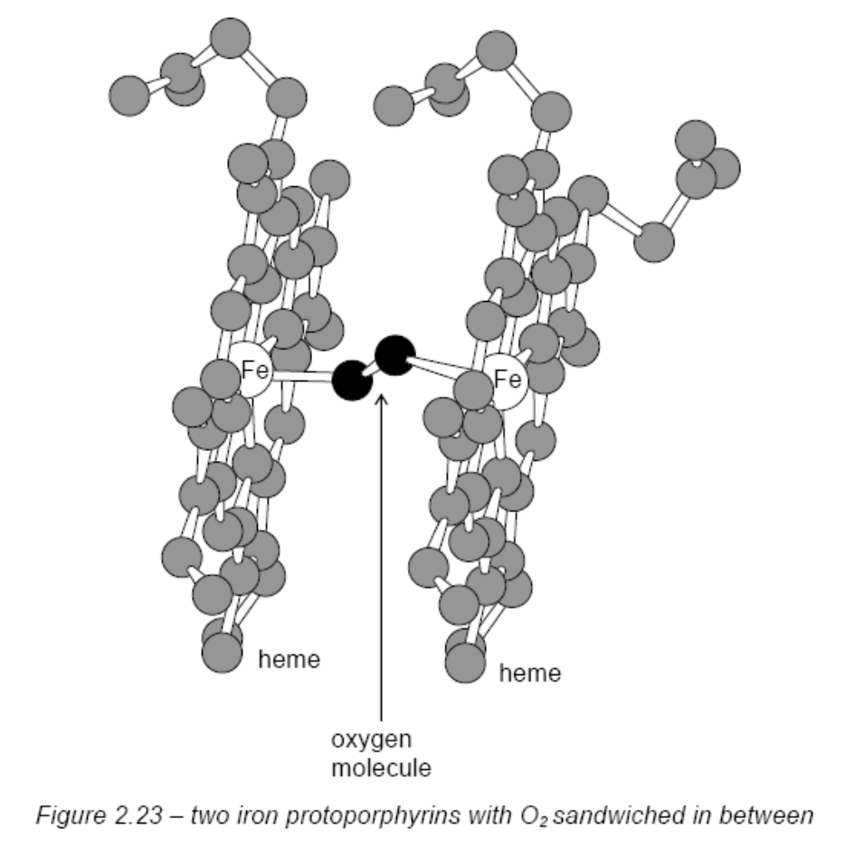
A key intermediate in this oxidation is a complex of an oxygen molecule sandwiched between two haem groups (Figure 2.23).

Slide 12
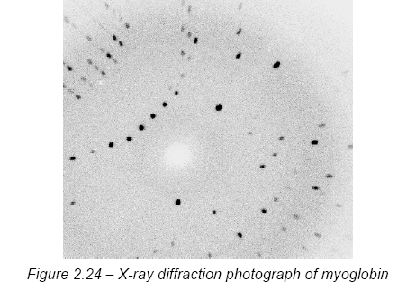
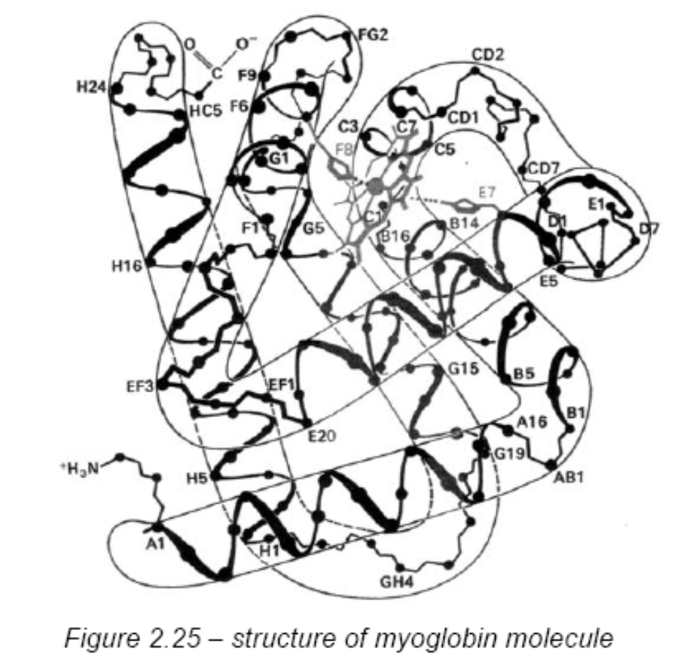
X-ray Crystallography
The myoglobin molecule is extremely compact, with a large percentage of its amino acids joined in the α-helical configuration.
This produced several stable, stiff “rods”, which are joined by small lengths of more flexible parts of the amino acid chain.

Slide 13
X-ray Crystallography
Oxygen-binding site is very hindered by the amino acids surrounding it, and the haem group is on the inside of the molecule.
Haem group is on the inside of the molecule makes it impossible for two such groups to come together with an oxygen molecule bridge between them, as in Figure 2.23

Slide 14
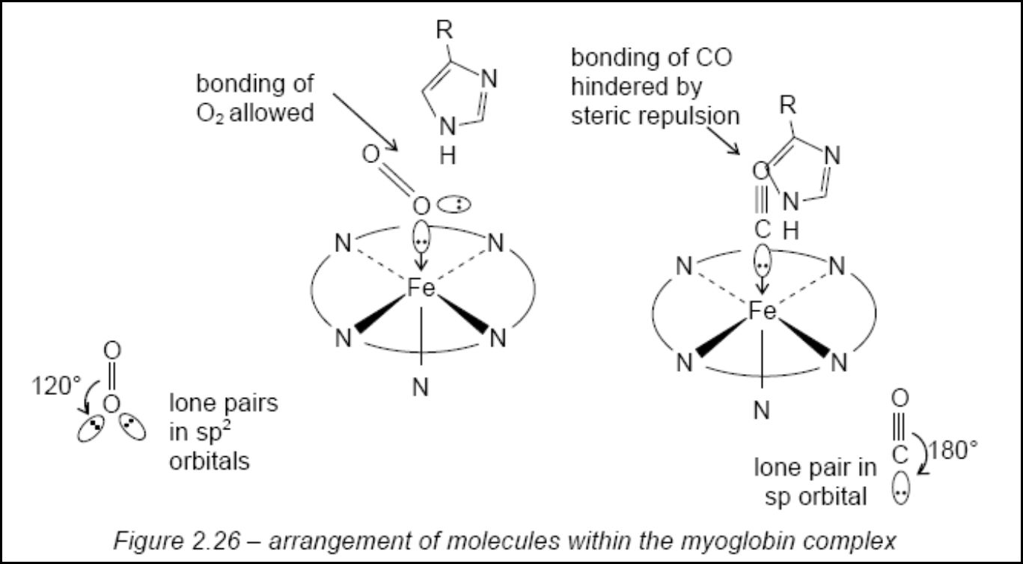
X-ray Crystallography
In addition, the second histidine group, above the Fe²⁺ ion, forces the complexing molecule to bond with the Fe²⁺ ion at an angle.
This favours O₂, but hinders the bonding of CO (see Figure 2.26).

Slide 15
PAST YEAR QUESTIONS

Slide 16
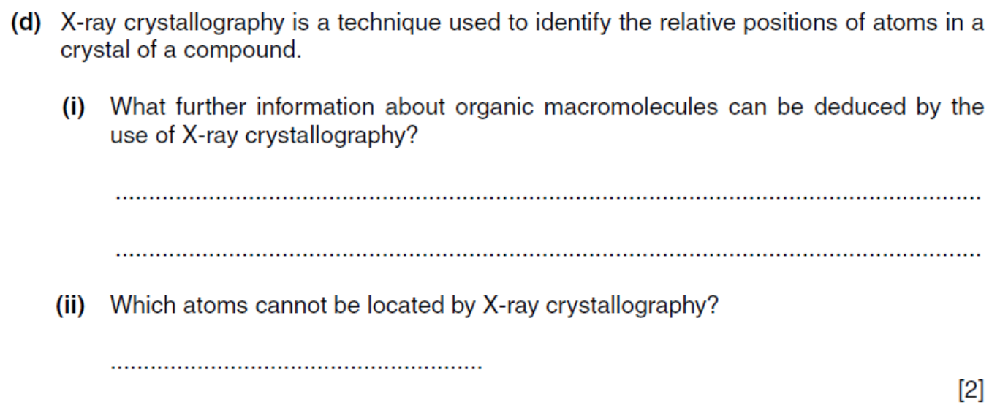

Question 1

Slide 17
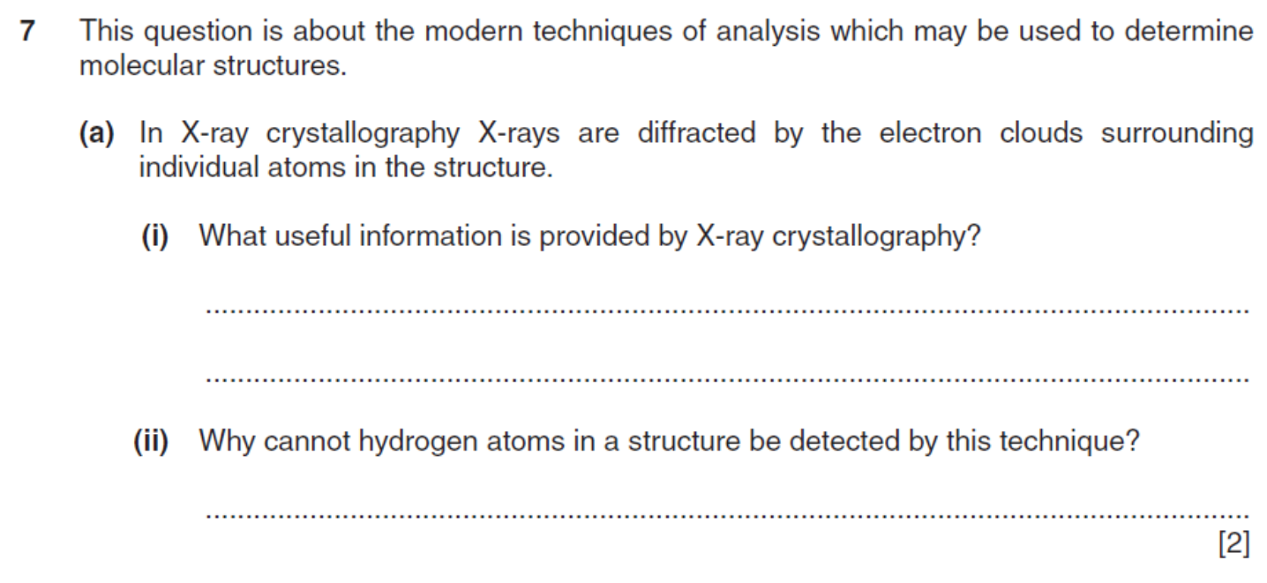

Question 2

Slide 18
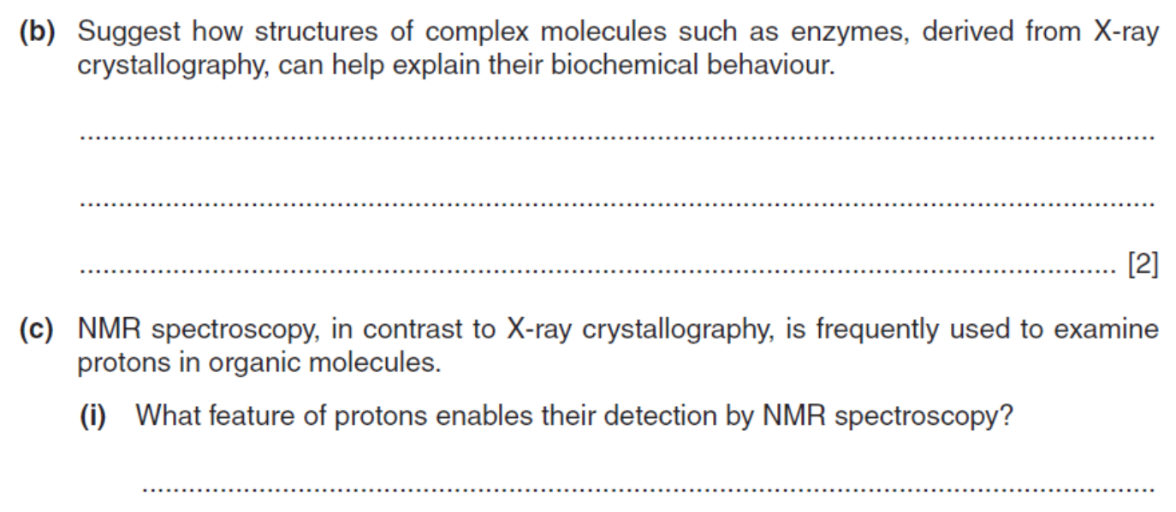

Question 2 cont’d

